Slide 1
Data structures and algorithms In JavaScript

Slide 2
How can we Compare programs
Example
Write a function that takes a string and
returns a reversed copy
https://stackoverflow.com/questions/958908/how-do-you-reverse-a-string-in-place-in-javascript

Slide 3
Which one to choose?
More readable
Take Less lines of code
Faster in execution
Less memory

Slide 4
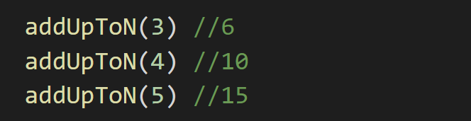
How can we Compare programs
Example
Write a function called addUpToN that takes a number (n)
and returns the sum of all the numbers from 1 to N

Slide 5
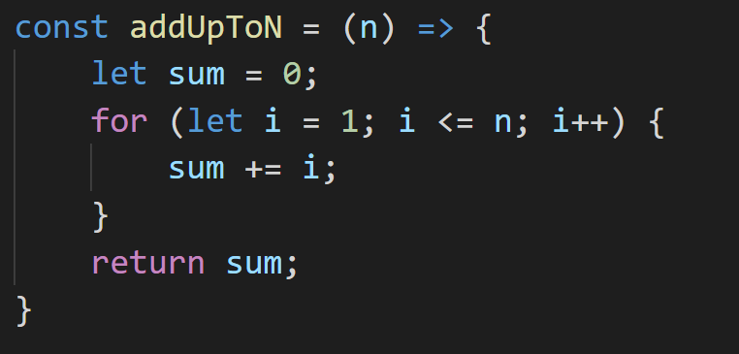
Solution 1

Slide 6

Solution 2
addUpToN(n) = 1 + 2 + ……………… + (n – 1) + n
addUpToN(n) = n + (n – 1) + ……………… + 2 + 1
-------------------------------------------
2addUpToN(n) = (n + 1) + (n + 1) + …………… + (n + 1) + (n + 1)
2addUpToN(n) = n * (n + 1)
$$addUpToN(n)=\frac{n ∗ (n+1)}{2}$$

Slide 7
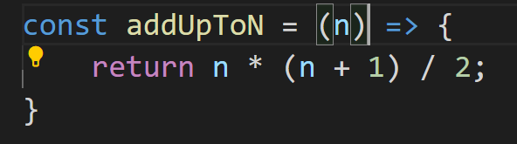
Solution 2

Slide 8
Which one to choose?
May be according to the time each one takes

Slide 9
Why Time cannot be a measure for the performance of the code?
Vary from device to device
Vary in the same device
Don’t give us an accurate measure

